Slide 1


Revision Control Guidelines
With Specific Suggestions for Matlab and Simulink
Covering: Git and SVN

Slide 2

Basic SVN
This presentation assumes you are familiar with basic SVN techniques. If not several good primers are available:
Video Series: Getting started with TortoiseSVN
The Red-bean book: Version Control with Subversion
These processes should be understood:
Updating, Committing, Branching/Merging, Reverting, Logs
These tools may be helpful for using a SVN repository on your computer
Tortoise SVN Client
Trac
WebSVN
Use an existing repository server like https://llcad-svn/
DISCLAIMER

Slide 3
Basic Git
This presentation assumes you are familiar with basic Git techniques. If not several good primers are available:
Basic Git Video Tutorial
Atlassian Git Tutorial
E-book
Some internal pages at the lab
Useful Links
Git Tips and Tricks
These tools may be helpful for using a Git repository on your computer
Git command line tools
Tortoise Git Client
Use an existing repository server like : https://llcad-github.llan.ll.mit.edu/
DISCLAIMER

Slide 4
File Structure
Conventional SVN repositories make use of three main folders
trunk: The main development effort
branches: Any efforts which are not ready for trunk or may effect others
Subfolder naming convention helpful: b_cls_PIcontroller_452
tags: mark any state that needs to be referenced in the future (a major release)
Nothing is lost in SVN
Plan on replacing old revisions with new files that have the same name so changes can be properly tracked
Delete old or obsolete models for clarity
If a variant must be produced use SVN copy and give it a new name
Use logs to find older files
Basic subfolders at top level are a good practice:
Ex: Doc, configs, GUI, top, sub-systems, libs

Slide 5
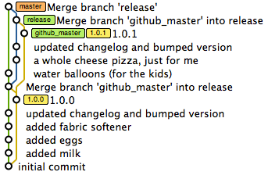
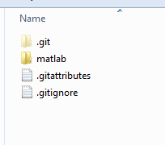
File Structure
All versions are stored and refered to by their sha value (hash). This will be unique for every commit.
Git uses distributed repository, so the entire repository is cloned to your working (local) repository.
The default branch is called master
Branching and tagging are similar to SVN
Merging branches and merging repositories are needed to keep work in sync.
Git keeps all its history in a folder labeled .git or in files that start with .git
.gitignore, .gitattributes
Git will add file markers to text based files when conflicts exist, or may make additional files when binary files are detected.
Try to avoid adding temporary merge files into the repository

Slide 6
What to check in
Usually a bad idea to check-in compiled files or derived binaries
How do you ensure these agree with the other source?
You can set ignore file types on a project basis
Entire directories
By file extension, suffix, etc
Binary files are OK, but just can’t be merged so need locks (on SVN)

Slide 7
Commit Messages
A brief note that will let others know what you have done
Error on the side of more information
What is the higher level context of this work?
Don’t just say upgraded filexyz. SVN already tells you that!
I added a saturation feature that will prevent overflow in recent test
Sometimes it may even be a good idea to include some of what you can get from repo logs but in a quick clean format
Merging branch b_cls_newThing1
What is tested? What works / doesn’t work? What is left to do?
Go back and read some old ones for perspective. What were they missing?

Slide 8
Branches
Branches are a good way to work on new features or bug fixes in an organized way
Allows to you do many commits as you test different aspects
If you break the overall functionality it won’t affect everyone else
Merging back to the trunk in one go makes it very clear all of these changes were related to the one issue
Merging can be tough but there are a few tricks
If needed start a new branch when you’re ready to merge, merge from your old branch to new branch, resolve conflicts, and then merge to trunk (SVN approach)
As you work on features in the branch discuss with others which files they are planning on modifying. Coordination like “I’ll do this, then you add that.” can go a long way.
Add a new file if your changes are too disruptive. Both versions can be kept around and then the earlier one removed from “circulation”

Slide 9
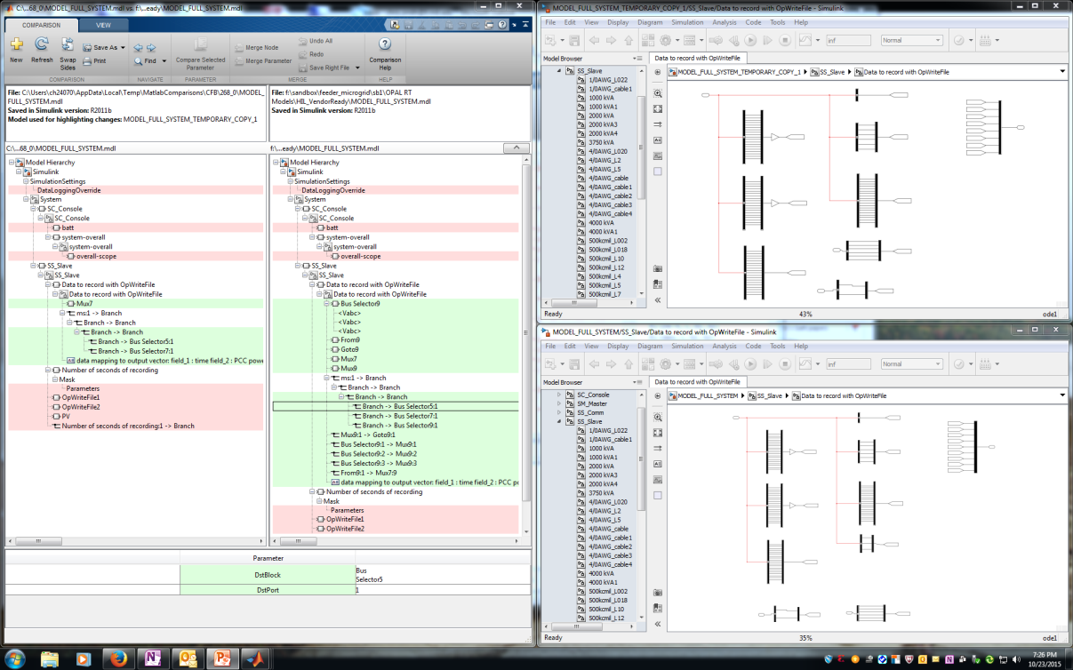
Matlab / Simulink
SVN/Git are now integrated directly into Matlab (80% solution)
File status icons in explorer pane
Many commands can be done directly from file view window
Diff capability for text and model files
Tag, but no branch or merge (update: added in 2016a)
Simulink
Slx model files are now binary, mdl were text
Diff for slx files still good
Merge is impossible so sub-divide files into logical pieces (more later)
Simulink project could be good?

Slide 10
Libraries
Libraries should be used whenever a re-usable block is created. Allows author to create:
A mask for high level config of parameters
Documentation
A sub-element that can be source controlled as a separate file
Top level tracking of any modifications
Libraries should include unit tests for components so that users know:
How it should be used
What was tested
I like the idea of small libraries (one file one library) from a source control perspective
Use file system folders for organization
And matching names for unit test (maybe with prefix/sufix)

Slide 11
Model Reference
Model reference allows one model to reference another standalone model file for modular development, unlike library:
Can obscure the contents to protect IP
Top model will be faster during compile and sim
One sub-system per file
Run mode for ref models can be different than parent: Accelerated
Simscape connections not supported!
Video with more information
I like the idea of using this for major sub-systems but not everywhere

Slide 12
Matlab Git Support
Git can be better because it allows for multiple repository servers
Local access when not connected to lab servers is helpful
Offsite partners can commit to their server and their changes can be “pushed” to lab server via a manual process with Lincoln employee go between
Additional features can at times be hard to learn and disruptive to development when still learning.
Many commands with switches to remember
Github type support is strong for having multiple users converge on one set of work
GUI type support is harder to find (than SVN) but improving
TortoiseGit is good and Git GUI from git-scm also decent

Slide 13
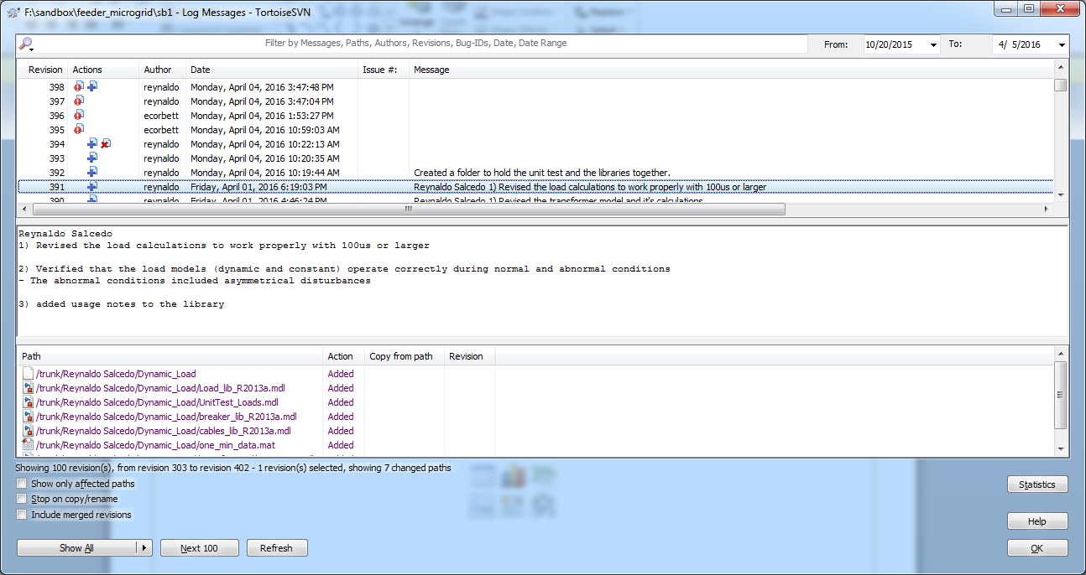
SVN Logging

Slide 14
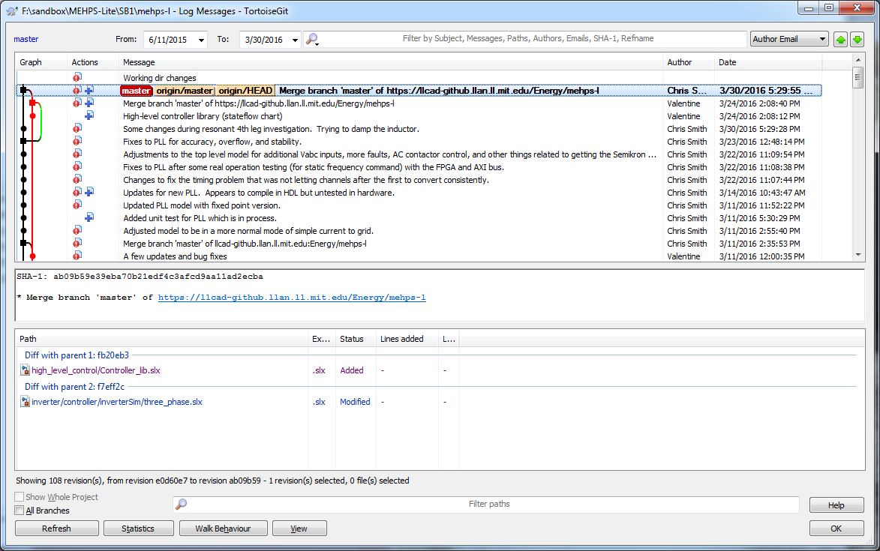
Git Logging

Slide 15
Simulink Project
As of 2014b it supports Git
Attempts to make native support for Git and SVN seamless but I’ve found you still need other tools and expertise to manage a repo
Can provide named shortcuts to for common tasks
Claims to support peer review workflows
Integrates with Github
In my opinion its probably worth a try . . . So I’ve setup our HIL repository to include it.

Slide 16
RT_LAB
Need: source control for the configuration and build process
Current process is not ideal
Copy all the repo files to a new directory
Click your way through several GUI dialogues to configure settings
Build the model, but ensure a few other options were checked first
Test and if small but important updates are needed make changes
A way for RT_LAB to operate on revision controlled files would be better
A build script would standardize the process and speed things up
Opal has given us a python example so I think a good standard work process could be established

Slide 17
Learn by Doing Examples on Git
Using our Practice Repo

Slide 18
HIL 2016 KEY POINT
Please ensure you are using
Other versions of matlab will create files that are at best
A mess with changes that aren’t really changes
Files that then can’t be opened by others
Damaged models that take a lot of time to fix
MATLAB 2013a

Slide 19
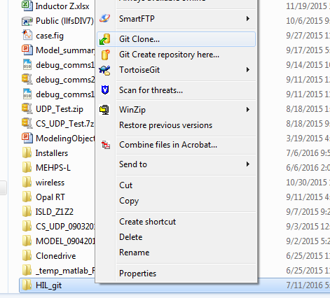
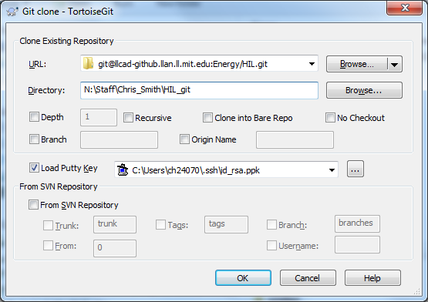
Checkout
Right click on your target folder. Choose “Git Clone”
Enter URL: git@llcad-github.llan.ll.mit.edu:Energy/Practice.git
Ensure directory is still good
Check your putty key is referenced

Slide 20
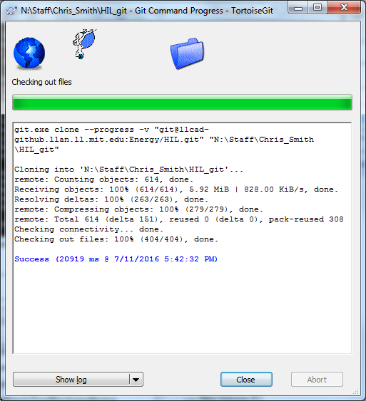
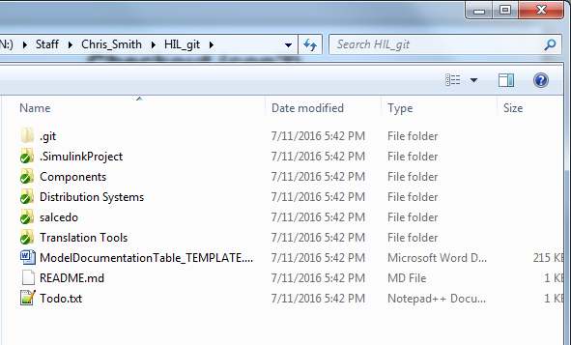
Checkout (con’t)
Check for success
And for new folders with icons:

Slide 21
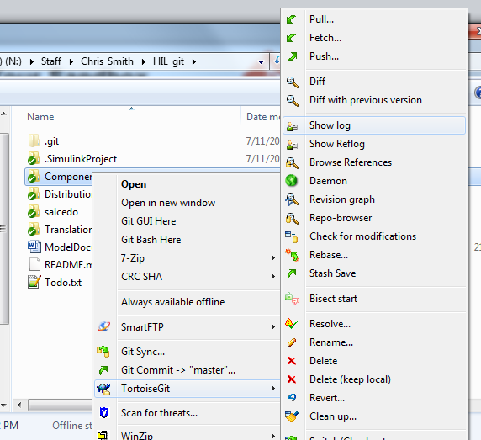
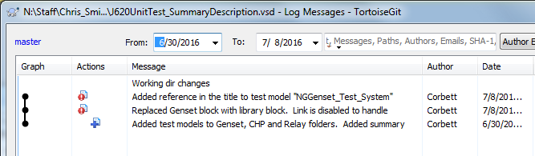
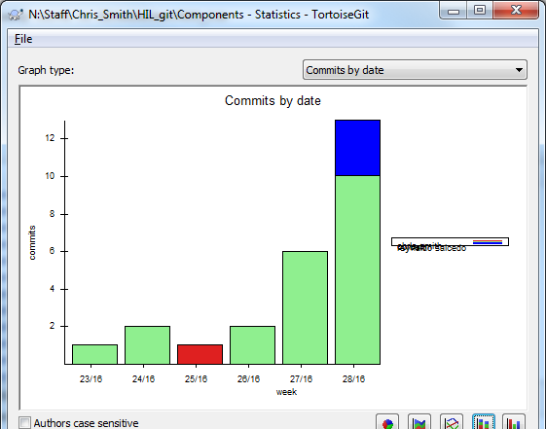
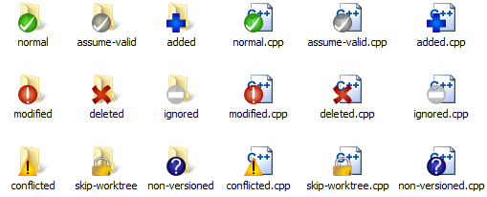
Work Within Your Sandbox
Can use multiple copies of the repository, revs, and branches
SB1: trunk
SB2: new feature that I’m working on but is taking awhile
SB3: code someone wants me to review
Logs are good to see what’s happened

Slide 22
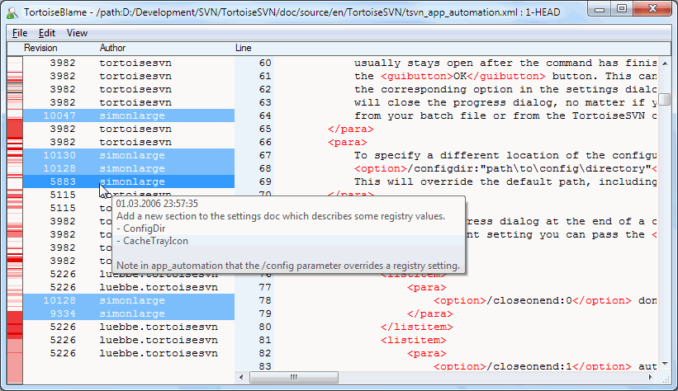
Blame
Blame (or maybe who / why / when)

Slide 23
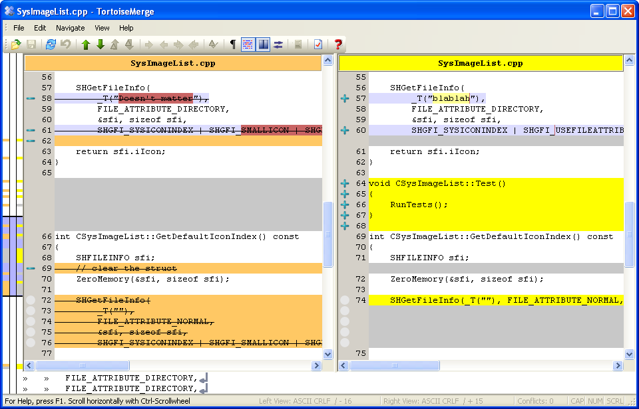
Diff
Diff files or whole directories that are red icons

Slide 24
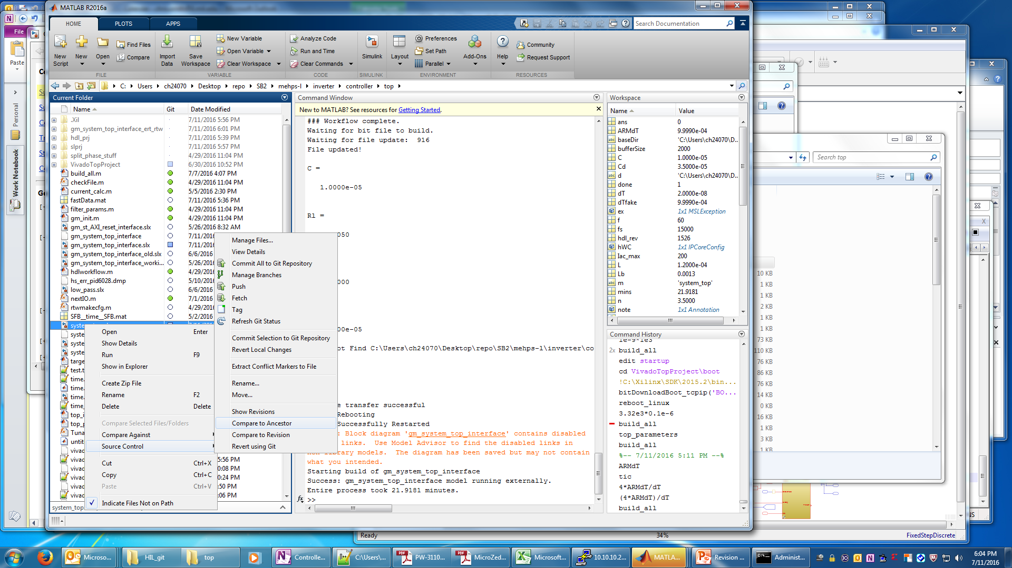
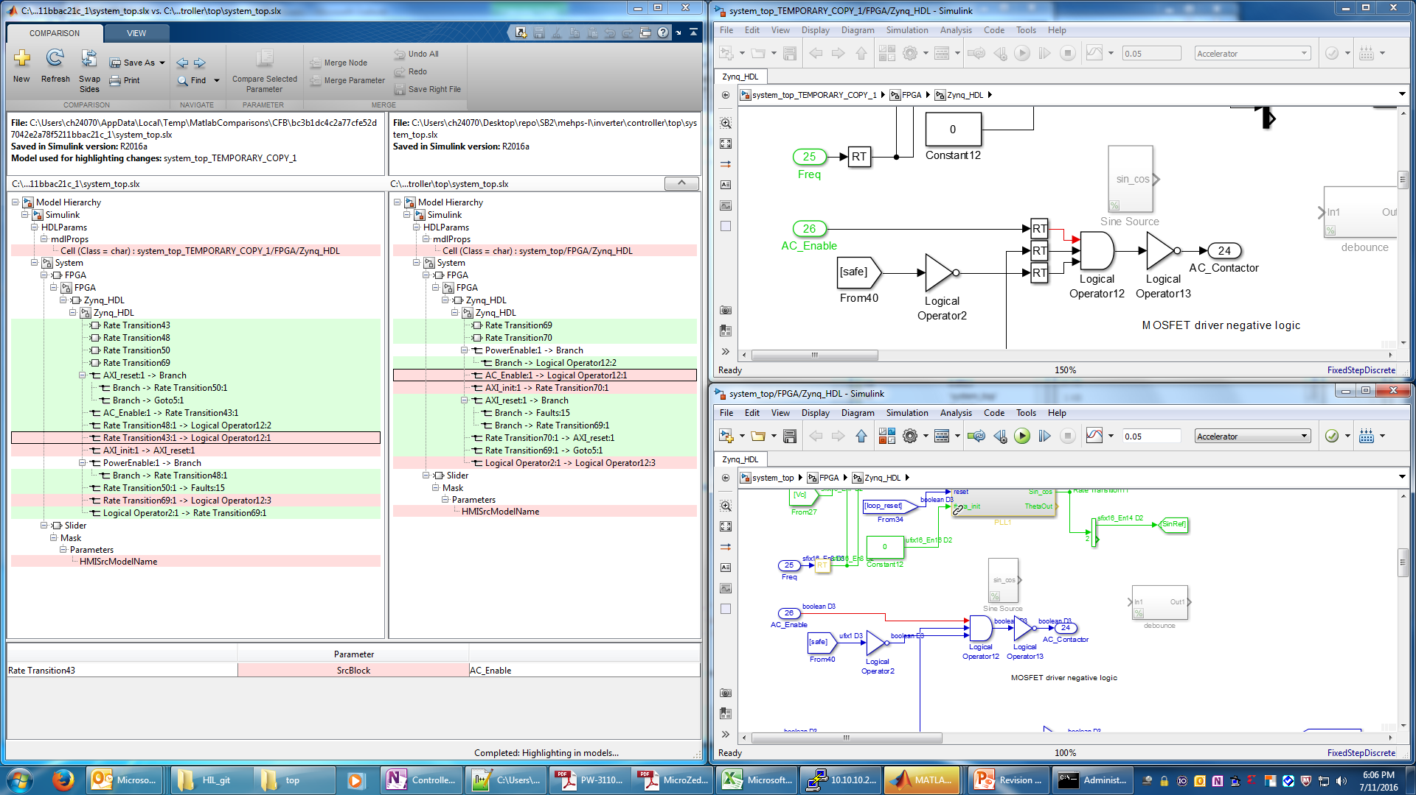
Diff
Can be done within matlab too for models:

Slide 25
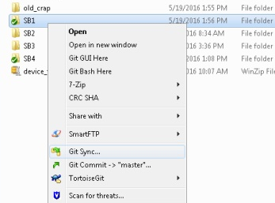
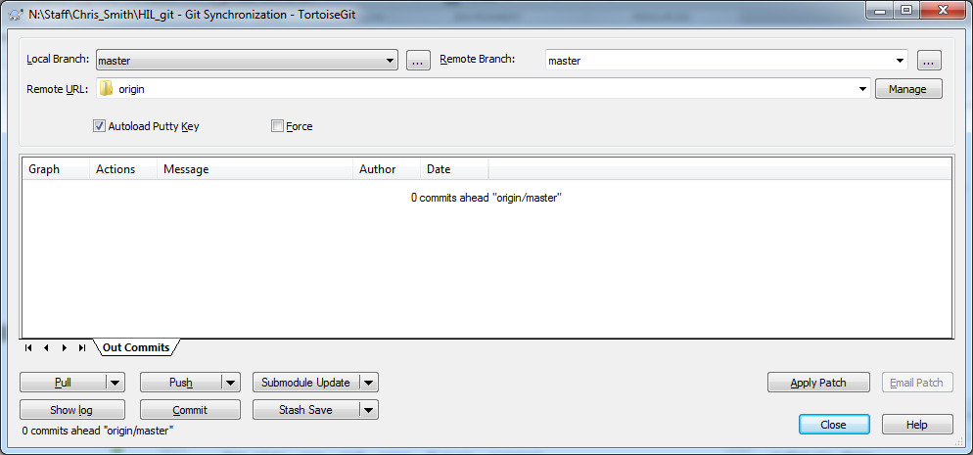
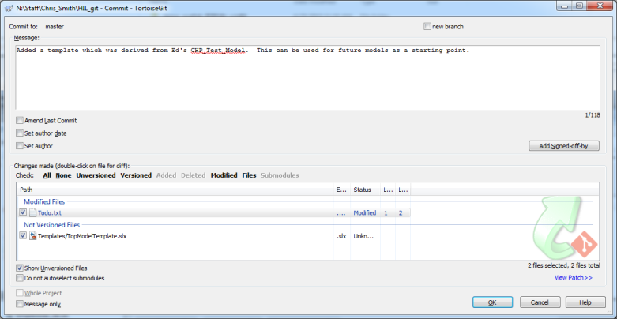
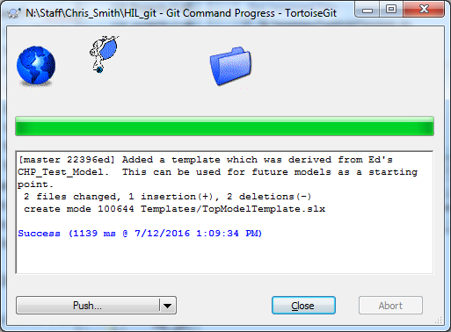
Commit
Commit small, push bigger
Process
Use Sync GUI, Commit
Check which files have changed. Double click on filename for diff
Add any new non-versioned files
Add a message that try's to answer why and how

Slide 26
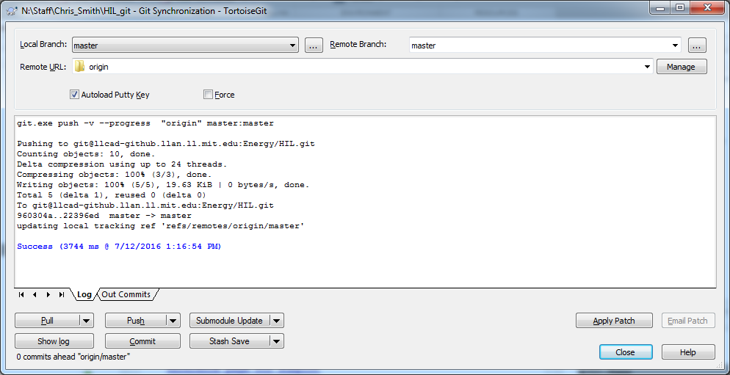
Push
Uploads your local commits to the central server
Process
Use Sync GUI, Push
Likely issues on push
Local copy not up to date
Do a pull
Cross your fingers someone didn’t touch the same files!
If they did do diff and manually integrate your changes

Slide 27
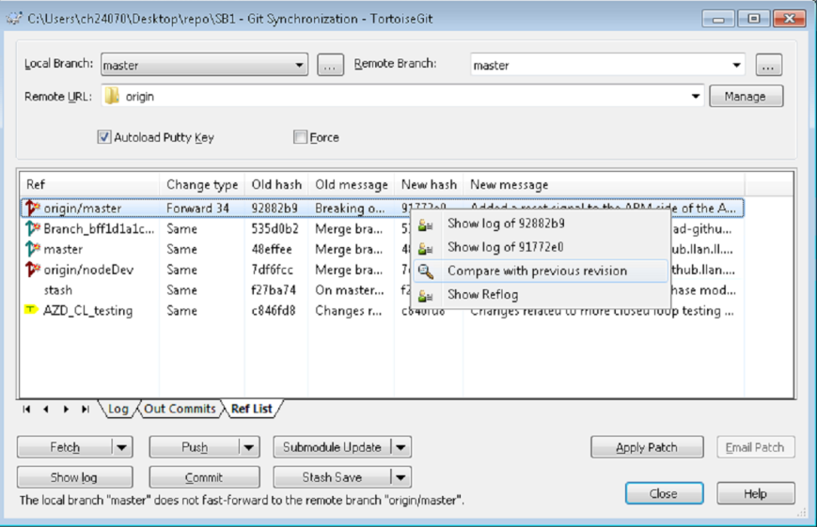
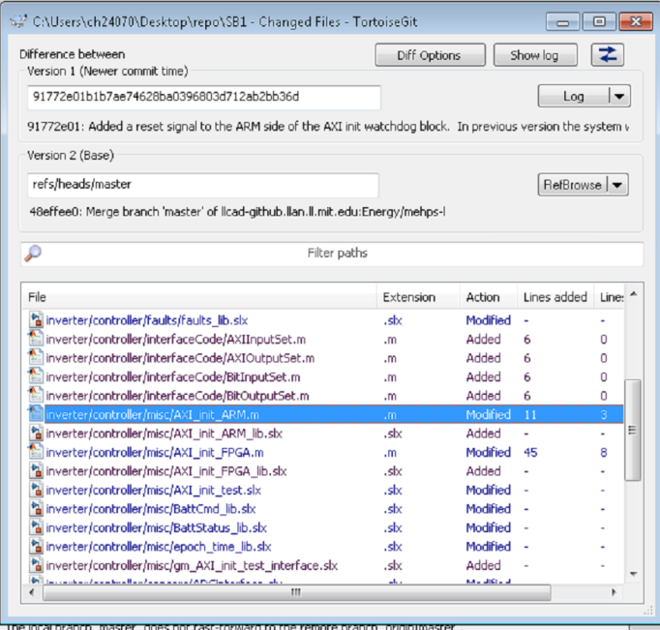
Look at Changes in master
Look at changes in master, several methods:
Use web based commit log to see what’s happened since you updated
Fetch from origin, compare your rev vs origin/master

Slide 28
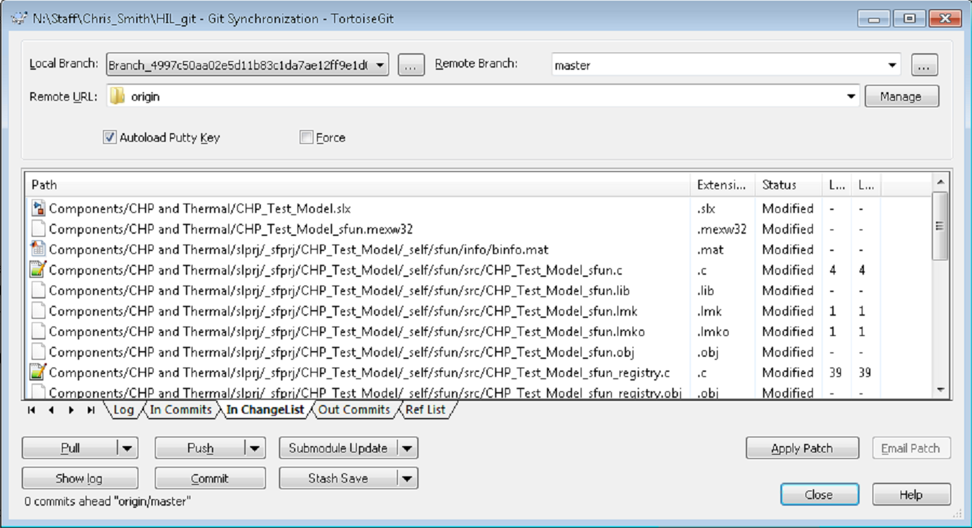
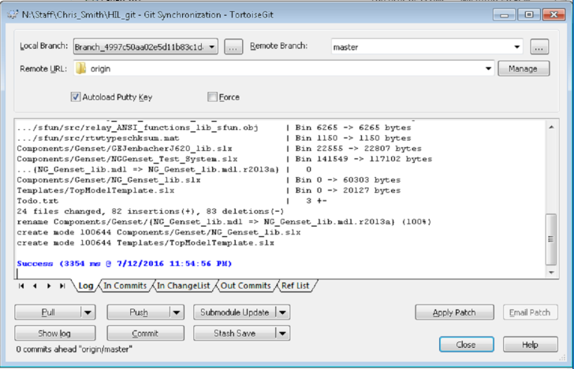
Pull
Pull will do a fetch and a merge
Good if you know there won’t be any conflicts and you just want to update your sandbox
Conflict can be resolved by one of the following:
Find the <<<<< markers. Manually edit text file. Mark resolved. Commit.
Take their version. And then re-do your changes. Commit.

Slide 29
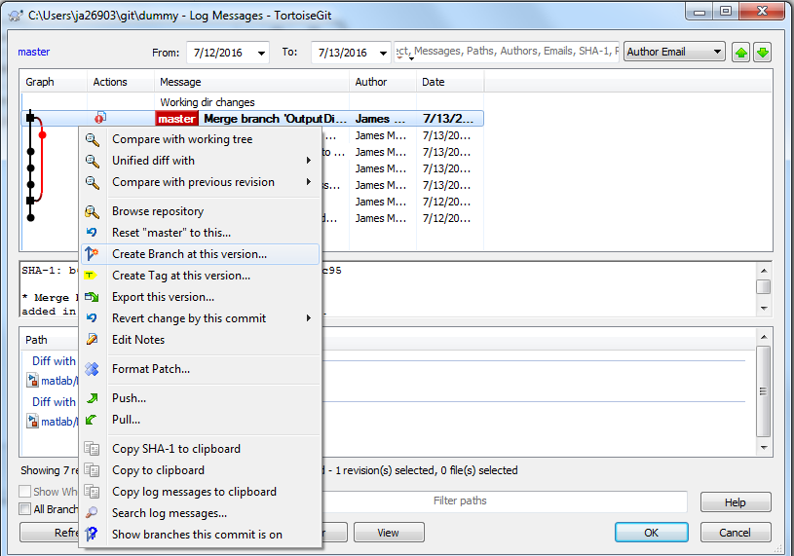
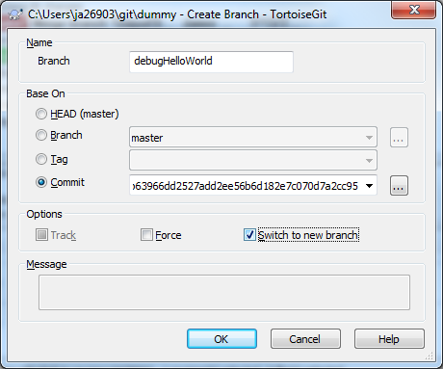
Branch
Branch is useful when
A task will take a long time to complete
You need to commit untested work
You are working on a complex task that you need to keep track of your work on
Create Branch at this version; Name the branch and select Switch to new branch

Slide 30
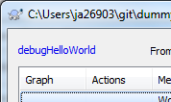
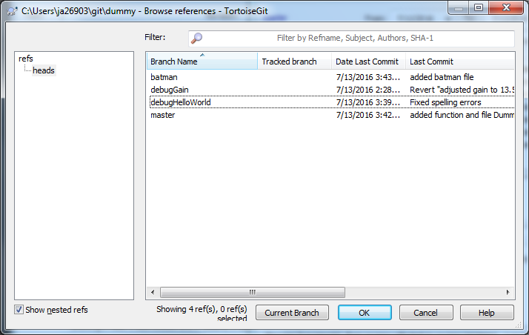
Branch (con’t)
Notice that the Branch name is shown in the top left corner
You can see branches in the repository browser

Slide 31
Work, commit, push
Commit to your branch often!
This will still be in your local cloned repository.
Publish to the remote repository requires a push (or pull)
You can either merge onto master (locally) and push your work to the master origin
OR you can push your branch to the remote repository.
Pushing your branch to the origin allows others to see your work (or update it) and to have server backup of your work.
If you are ready to push your work to master
Pull the changes on master from the origin, onto your local master.
Merge your work onto master.
TEST (no really… test the merge)
Verify your work is there
Verify you have not removed anyone else work
Push to master on origin

Slide 32
Merge
Likely issues
Text files will try and auto merge
Binary files that are only changed on one branch, git will pick the most recent one
Files will be in a conflict state if there are any changes that git cannot simply merge.
Binary files that are both changed will conflict, and merging must be done externally.
After a merge, Git will need to commit. This will be done automatically if there are no conflicts.

Slide 33
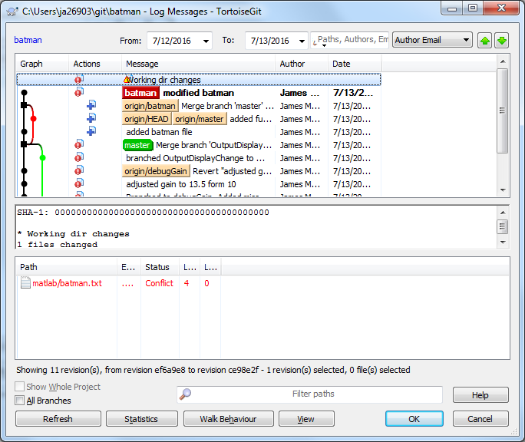
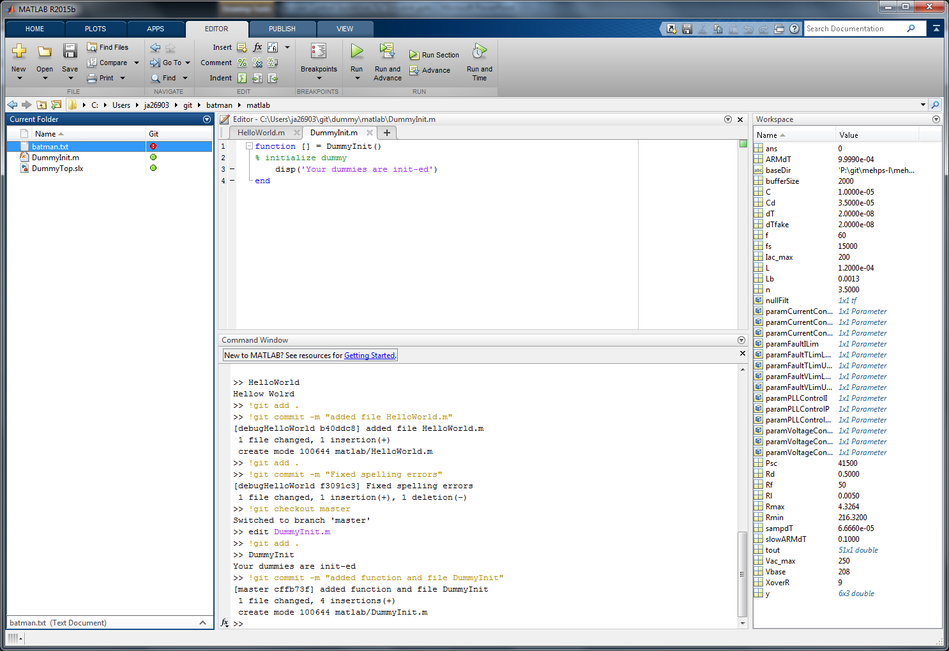
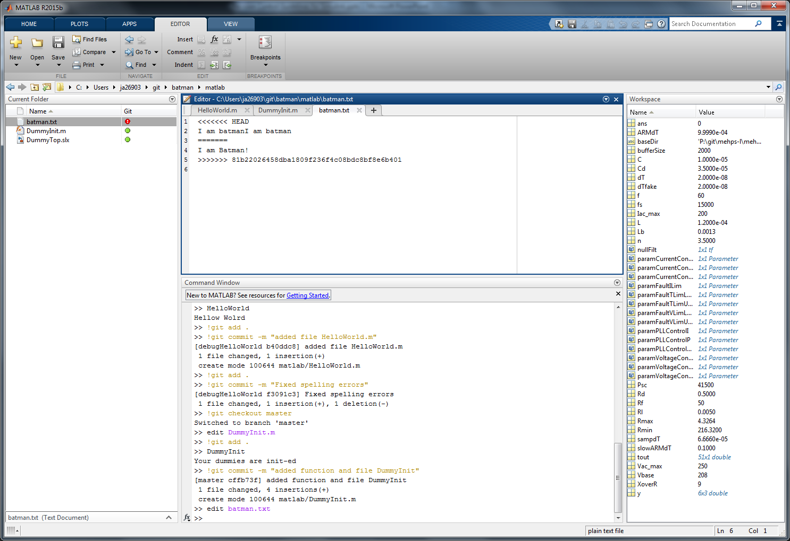
Conflicts (text file)
Status shows conflict.
Conflicts must be resolved before a merge can complete, and a merge must be completed or aborted before any other commits may take place.
Text file has <<<HEAD and >>>>
With a ===== line separating them
Fix the file and remove any conflict markers.
Stage and commit the changes

Slide 34
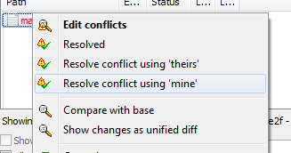
Conflicts (binary files)
Need to use the tool that created to binary file to edit them (ie. excel, simulink)
Some tools have functions to find differences in their files.
Need to get to a single complete file to check in without overwriting changes from either file.
You can then tell git to resolve using ‘mine’ (this is the local working file)
Stage and commit your work

Slide 35
Other things
Go back to an older rev
Stash
Used when you want to take local changes and temporarily put your work on hold (example: work on a code change, and you aren’t sure if you just broke something, or if it was broken before; you might use a stash to back burner your changes, test the last version, and them pull your work back into your working files.
Review a branch

Slide 36
Matlab Project Integration on HIL
Templates
Setup script
Path
Other workspace variables
Check version of matlab
RT-LAB script

Slide 37
Potential Issues
Different versions of Matlab
Working on the same (binary) files
Strive to partition your models into smaller pieces, with separate files
Communicate with others about which files you will be touching
Matlab 2016a supports merge on models which makes it easier but doesn’t solve everything or eliminate the need for communication

Slide 38
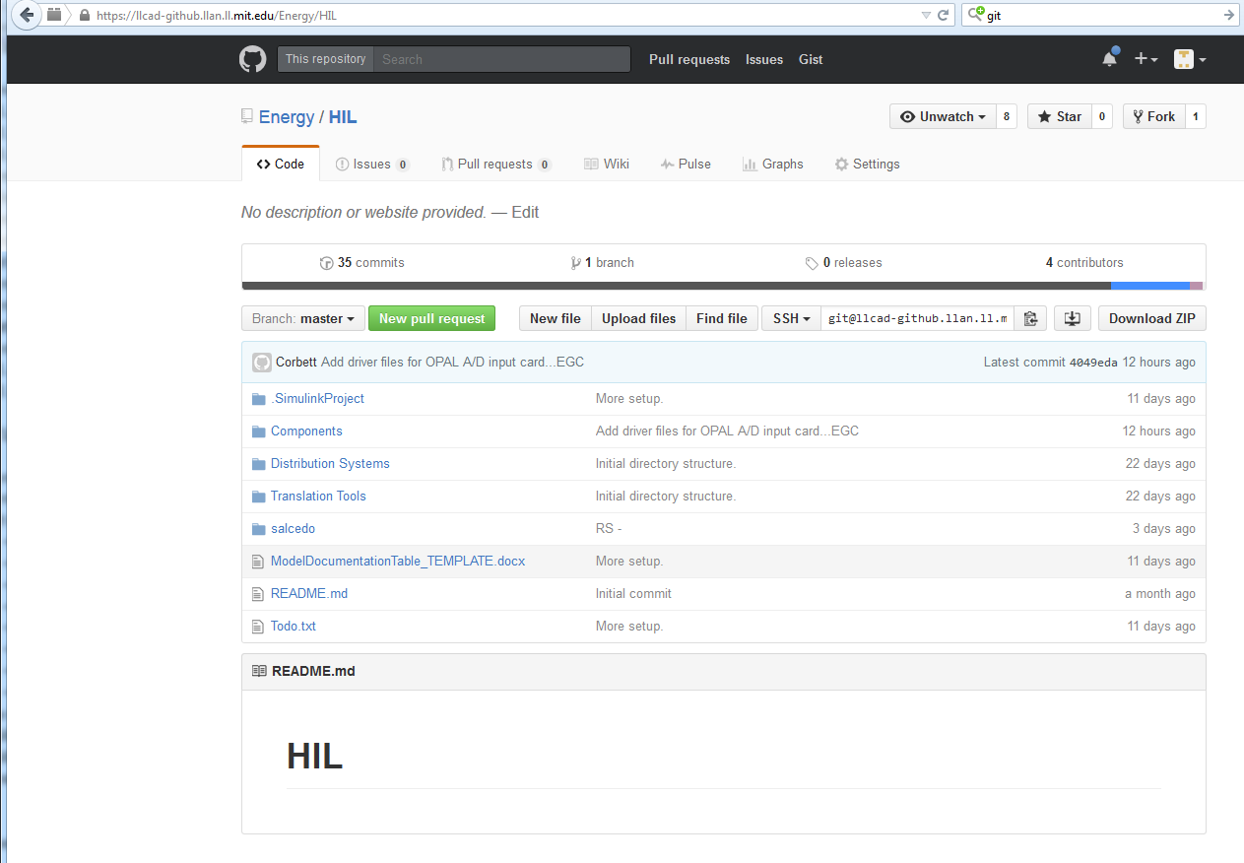
LLCAD Github
https://llcad-github.llan.ll.mit.edu
Can be great for getting a quick look at what’s been happening or a detailed snapshot of file history

Slide 39
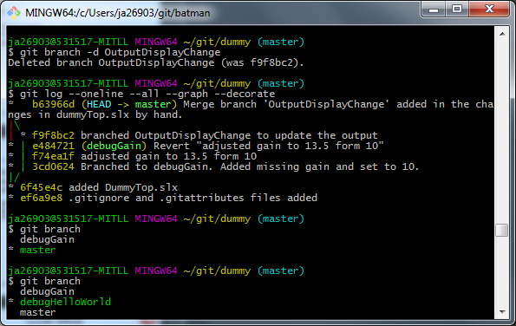
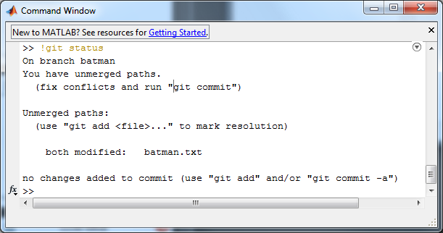
Command Line
Git is build on a series of scripts and command line calls.
Online trouble-shooting will likely show the git command to complete an action
Access to the command line can be done via Git Bash
Git commands can also be run from matlab using a ! In front of the command.

